Slide 1
Analysis of Patients with Myelofibrosis (MF) Using Optum and Truven Data Survival Analysis June 02, 2016

Slide 2
Content
Survival analysis
Business Rules
Key results
1

Slide 3
Business rules for Treatment Pattern Analysis (1/3)
Sr no | Business rules | Rationale
1 | The usage of Myelofibrosis drugs^ and steroids alongside exposure to radiation and Splenectomy will be analyzed individually: Treatment period for a therapy would be the period from the first date of use to the last date of use. The latter is the date when there is at least a 90 day gap between the day the supply of a claim for a drug is exhausted and the day of the next claim for the same therapy. See 1c for imputation rules for assigning the days of supply for a particular therapy. A therapy used multiple times with a gap of 90 or more days will have multiple treatment periods (start dates and end dates) For an oral therapy, the end date for each treatment period would be the last Rx date in that treatment period + days supply (days supply is assumed to be to be 30 days in case the data is not present in claims data or days supply is less than 15 days) for all oral therapies. A clinical benefit of 30 days is assumed for all injectables, radiation and splenectomy. | A period of 90 days was considered in order to ensure that the core MF therapy, Jakafi, is monitored for a sufficient period of time. consecutive prescriptions is less than 90 days. Therefore, period of 90 days has been considered
^Myelofibrosis Drugs: RUXOLITINIB, BUSULFAN, CYCLOPHOSPHAMIDE, DANAZOL, ERYTHROPOIETINS, FLUDARABINE, FLUOXYMESTERONE, HYDROXYUREA, LENALIDOMIDE, MELPHALAN, NANDROLONE DECANOATE, OXYMETHOLONE, POMALIDOMIDE, THALIDOMIDE, METHANDROSTENOLONE
Steroids: DEXAMETHASONE, PREDNISOLONE
Surgery and Procedures: SPLENECTOMY, RADIATION
2

Slide 4
Business rules for Treatment Pattern Analysis (2/3)
Sr no | Business rules | Rationale
2 | Once the different treatment periods of each MF therapy have been identified, these periods are lined up such that the entire treatment duration for a patient is broken up into multiple intervals, each with a distinct regimen (i.e. a single drug or a combination of drugs). Each such successive interval is deemed to be a different line of treatment for a patient, subject to the below stipulations: If a regimen comprises of Jakafi (only drug approved to treat MF patients) and any other MF drug and a steroid(s), the regimen will be replaced with only Jakafi and the other MF drug (i.e. the steroids will be excluded). If a regimen comprises an ‘other MF drug(s)’ along with a steroid, the regimen will be replaced with only the ‘other MF drug(s)’. In other words, the steroid will be deleted from the regimen. Upon completion of step a, all successive regimens that are identical and occur without any gap between them will be merged into the same LOT. If any regimen has a duration of <=30 days, and if its succeeding regimen is a step up or step down regimen, then the 2 regimens should be merged, with the one with the higher duration being considered the prevailing regimen. If the succeeding regimen is not a step up or step down or there is no succeeding regimen, then the regimen should be compared with the preceding regimen and the same rule applied. For 2 regimens to be considered step up or step down of each other, all the drugs of the smaller regimen should be contained in the larger regimen.
3

Slide 5
Business rules for Treatment Pattern Analysis (3/3)
Sr no | Business rules | Rationale
Blank regimens where no usage of any drug is found would be treated in a following manner
2 | Upon completion of each of steps a-c and prior to proceeding to next step, all successive LOTs that are identical (regimens should be exactly the same) and occur without any gap between them will be merged into the same LOT If a regimen comprises only a steroid(s), the regimen will be disregarded and replaced by a blank, if the duration of the regimen is <30 days. Else, the regimen will stand and no change or adjustment will be made
3 | The following rules shall be applied to regimens occurring between blank regimens: If the duration of blank regimen is <90 days: If preceding and succeeding regimens are the same; then the preceding regimen will be deemed to continue till the end date of the regimen succeeding the blank regimen. If duration of the blank regimen is <30 days and preceding and succeeding regimens are similar, with one being a step up or step down of the other, and either of them are <=15 days, and the blank regimen is <30 days, then merge the 2 regimens together. The regimen with higher duration will be the prevailing regimen. Blank regimens will be deleted if the duration is >=90 days. | During treatment with any regimen, a gap of up to 90 days could exist on account of compliance or management of adverse events. Therefore If preceding and succeeding regimens are the same, the 2 periods would be treated as continuous In all other cases they would be treated as two different regimens
4

Slide 6
Survival Analysis – Business Rules (1/2)
Eligible patients:
Patients who are treated with Jakafi or others drugs in their first and second line of treatment (LOT1 and LOT2).
Patient cohorts of interest:
The survival analysis was carried out for the following patient cohorts:
Cohort 1: Patients who are treated with Jakafi or others regimen in LOT1 in OPTUM database
Cohort 2: Patients who are treated with Jakafi or others regimen in LOT2 in OPTUM database
Cohort 3: Patients who are treated with Jakafi or others regimen in LOT1 in TRUVEN database
Cohort 4: Patients who are treated with Jakafi or others regimen in LOT2 in TRUVEN database
Cohort 5: Patients who are treated with Jakafi or others regimen in LOT1 in Combine database
Cohort 6: Patients who are treated with Jakafi or others regimen in LOT2 in Combine database
5

Slide 7
Survival Analysis – Business Rules (2/2)
Definition of Events and Censoring:
If death date is available in the data: Treat the death date as an event.
If death date is missing in the data:
If the last claim date is >=90 days prior to study end date then last claim date is treated as an event.
If above condition is not satisfied (i.e. the last claim date is <90 days prior to study end date) then censor the patient at last claim date.
Study End Date:
OPTUM: 23-Apr-2015
TRUVEN: 18-Jul-2015
Calculation of time to event:
Duration= Censor date – Start date of respective LOT + 1

Slide 8
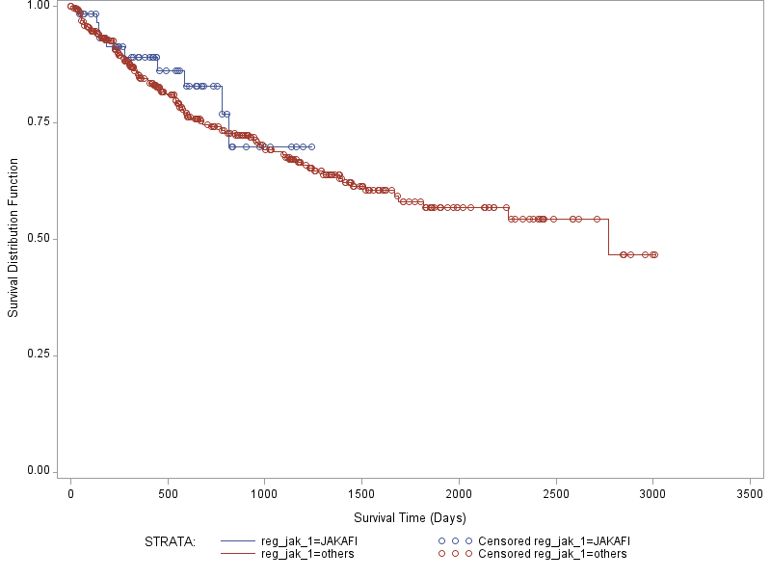
Survival Analysis (Cohort 1)
Time from the start of LOT1 (Jakafi vs Others) to death in OPTUM database
Summary statistics (in days)
Statistic | Jakafi | Others
N | 63 | 385
Number of events | 10 | 108
Mean | 721.47 | 1866.83
Median | Not achieved | 2769
Quartiles [Q1, Q3] | [812, NA] | [682, NA]
Standard error | 30.74 | 70.59
P-value | 0.4984
7

Slide 9
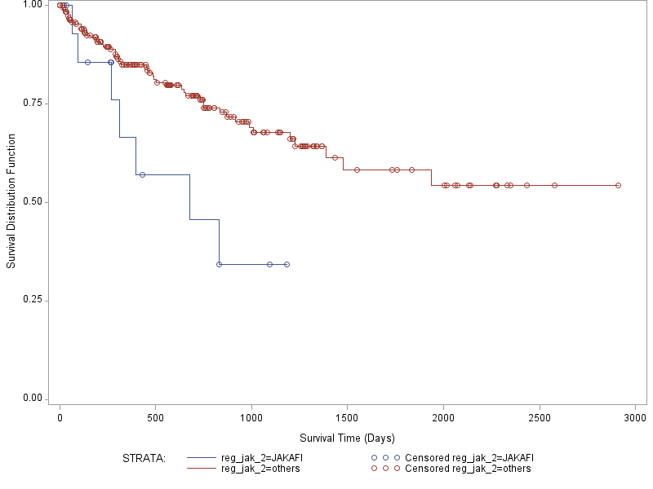
Survival Analysis (Cohort 2)
Time from the start of LOT2 (Jakafi vs Others) to death in OPTUM database
Summary statistics (in days)
Statistic | Jakafi | Others
N | 16 | 201
Number of events | 7 | 49
Mean | 560.22 | 1406.36
Median | 677 | Not achieved
Quartiles [Q1, Q3] | [309,NA] | [749,NA]
Standard error | 91.13 | 64.05
P-value | 0.0138
8

Slide 10
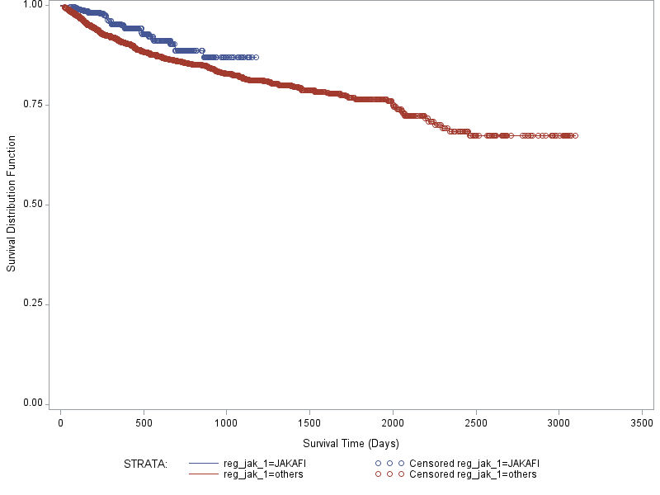
Survival Analysis (Cohort 3)
Time from the start of LOT1 (Jakafi vs Others) to death in TRUVEN database
Summary statistics (in days)
Statistic | Jakafi | Others
N | 433 | 3078
Number of events | 29 | 391
Mean | 807.35 | 2011.26
Median | Not achieved | Not achieved
Quartiles [Q1, Q3] | [NA,NA] | [2008,NA]
Standard error | 9.16 | 21.55
P-value | 0.0137
9

Slide 11
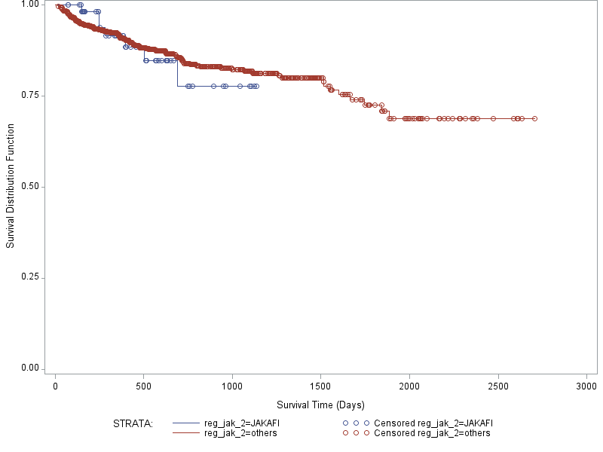
Survival Analysis (Cohort 4)
Time from the start of LOT2 (Jakafi vs Others) to death in TRUVEN database
Summary statistics (in days)
Statistic | Jakafi | Others
N | 59 | 1032
Number of events | 7 | 128
Mean | 633.77 | 1583.18
Median | Not achieved | Not achieved
Quartiles [Q1, Q3] | [NA,NA] | [1665,NA]
Standard error | 22.45 | 25.18
P-value | 0.8328
10

Slide 12
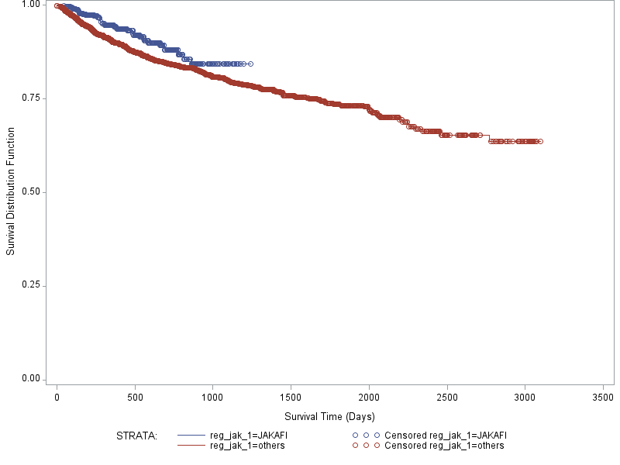
Survival Analysis (Cohort 5)
Time from the start of LOT1 (Jakafi vs Others) to death in Combine database
Summary statistics (in days)
Statistic | Jakafi | Others
N | 496 | 3463
Number of events | 39 | 499
Mean | 799.98 | 2168.43
Median | Not achieved | Not achieved
Quartiles [Q1, Q3] | [NA, NA] | [1670,NA]
Standard error | 9.0 | 25.96
P-value | 0.0140
11

Slide 13
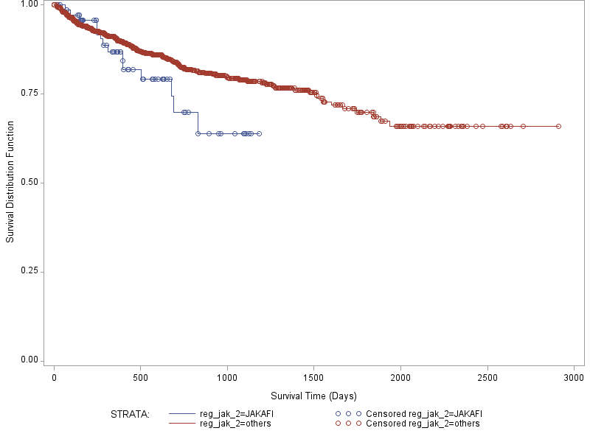
Survival Analysis (Cohort 6)
Time from the start of LOT2 (Jakafi vs Others) to death in Combine database
Summary statistics (in days)
Statistic | Jakafi | Others
N | 75 | 1233
Number of events | 14 | 177
Mean | 703.66 | 1578.59
Median | Not achieved | Not achieved
Quartiles [Q1, Q3] | [677,NA] | [1514,NA]
Standard error | 31.76 | 24.96
P-value | 0.1082
12

